Slide 1
3DMark Fire Strike RTX 3000 Regression Modeling
Caesar Dominic Lindog
Notes:
Define the importance and potential data sets like this can bring – market influence, predict scores of future generations, etc.

Slide 2

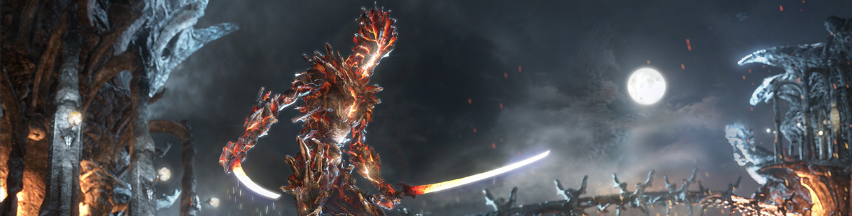


3DMark (Consumer Space)
Fire Strike (DX11)
Time Spy (DX12)
Port Royal (RT)
Notes:
Define the benchmarks’ strengths and weaknesses.

Slide 3
3DMark (cont’d)
Fire Strike (DX11)
Notes:
Define the benchmarks’ strengths and weaknesses.

Slide 4


3DMark (cont’d)
A UL service that mainly deals with consumer PCs
Why 3DMark?
It tests both the CPU and GPU intensively while disregarding manufacturer optimization bias.
Contains DirectX APIs that covers archaic rasterization methods and new ones built for multi-core CPUs
300,000+ results available for viewing
Notes:
3DMark introduction – what is it used for and why I chose it.

Slide 5
Rationale (Why 3DMark?)
“What about other benchmarking tools? Real-world tools and video games?”
Potential Predictive Power
Ever-expanding
Public Data
Notes:
AMD – value-oriented; Intel – performance-oriented

Slide 6
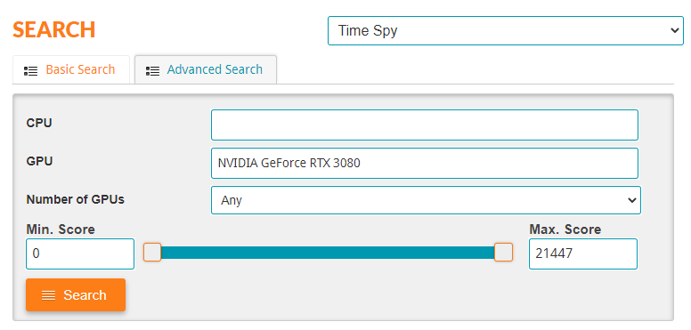
Setting the Scope
3DMark Classic Search tab
Only Nvidia GeForce RTX 3070, 3080, and 3090 Firestrike results were scraped and wrangled from 3DMark, totaling to about 40000+ results
Notes:
For almost two decades, two notable archrivals in the semiconductor industry, Intel and AMD, have been at each other’s throats. AMD has been trying to dethrone Intel with the introduction and improvements of Ryzen.

Slide 7
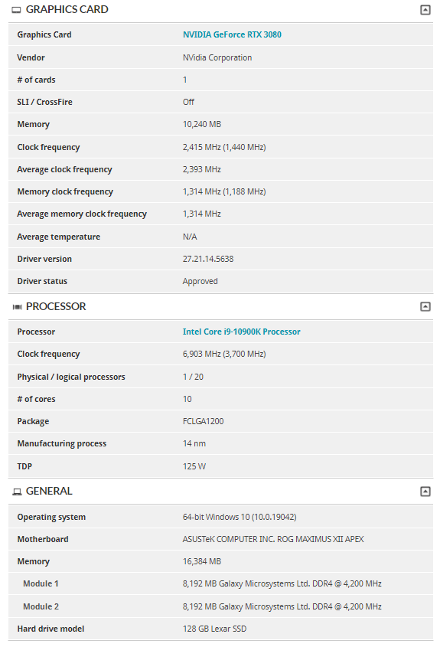
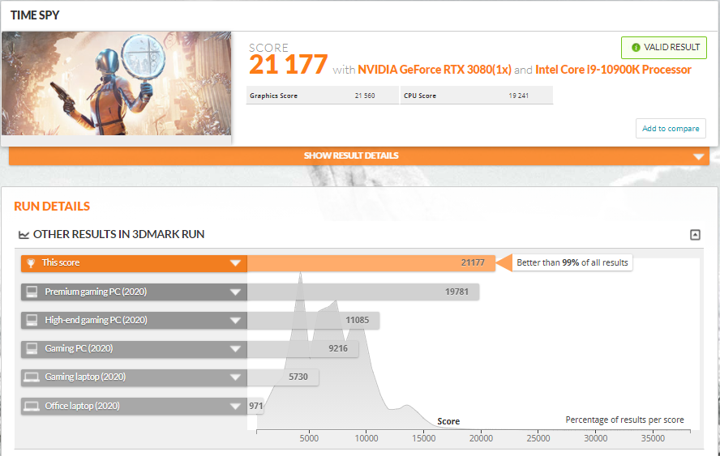
Results Summary
Highlighted data represents collected data
Notes:
For almost two decades, two notable archrivals in the semiconductor industry, Intel and AMD, have been at each other’s throats. AMD has been trying to dethrone Intel with the introduction and improvements of Ryzen.

Slide 8
Potential Pitfalls
Highly skewed score from data set
Due to time constraints, it might be impossible to scrape all relevant data
Sample size (scraper limit)
With the same time-related problem
Specificity
Model results possibly only applies to RTX 3000 GPUs
Notes:
Time-sensitive pitfalls.

Slide 9
Goals
Having a model with >75% test score
This initial score will provide an insight on how well it would perform with all the configurations possible
Mobile App
Still a work-in-progress; shows an approximate range of scores possible with the least variance given a set of CPU, GPU, RAM with respective clock speeds and capacities.
Notes:
Time-sensitive pitfalls.

Slide 10
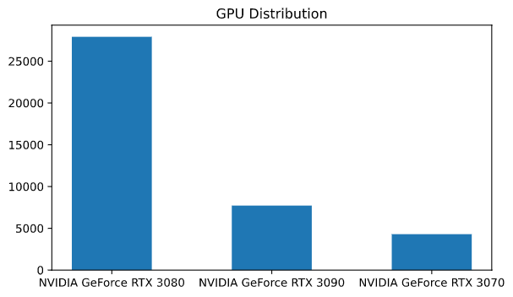
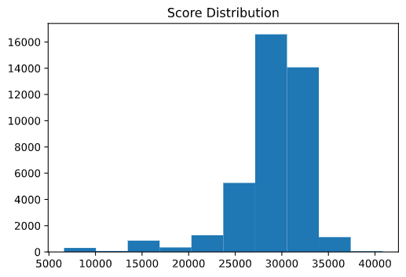
EDA
Derivative Scores
Derivative Scores
Multicollinearity
Multicollinearity

Slide 11
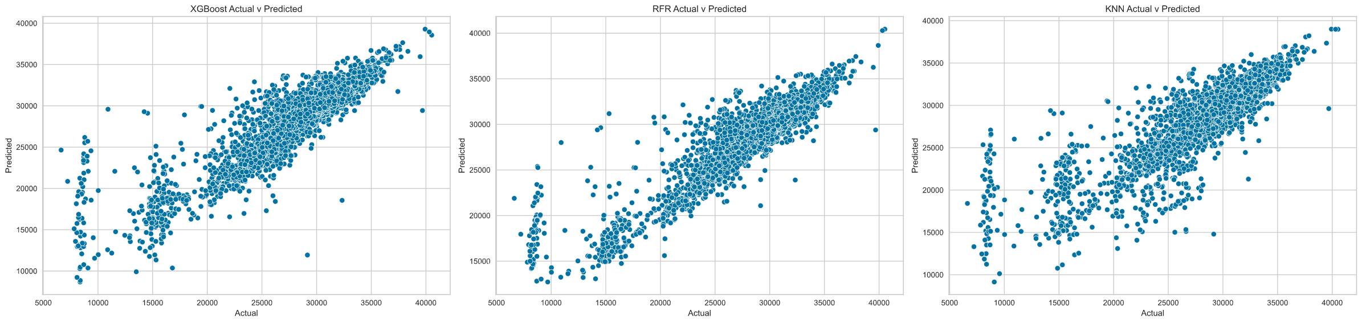
Model Selection
Model | Train Score | Test Score | Mean CV Score | RMSE
XGBoost | 0.8816 | 0.8205 | 0.73 | 1683.62
Random Forest | 0.9756 | 0.8429 | 0.74 | 1575.20
KNN | 0.8476 | 0.7710 | 0.68 | 1901.62

Slide 12
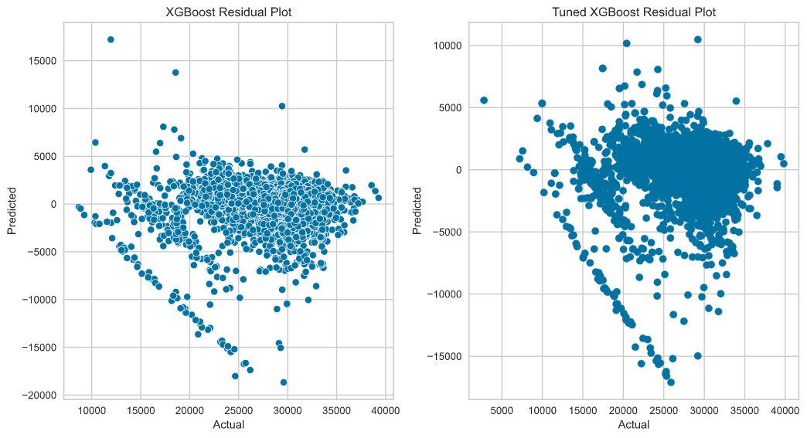
Tuned XGBoost
Less variance, but the negative slope is still present

Slide 13
Summary
Tuned XGBoost model provided desirable results
Regression Modeling : Success
Notes:
How will you be avoiding this?

Slide 14
Summary (cont’d)
To have less errors and more predictive power:
1. Scraping more RTX 3070 data once available
2. Results outside RTX 3000 GPUs
3. Feature importance
Also, I do intend to release a rudimentary mobile app that would take in a CPU, GPU, and RAM with respective clock speeds that would output a range of 3DMark Fire Strike scores with the least variance possible.
Notes:
Mention of future plans using the same data set.

Slide 15
Thank you.
Notes:
Define the importance and potential data sets like this can bring – market influence, predict scores of future generations, etc.

